Slide 1

Problem Solving Session
The remainder of today’s class will comprise the problem solving session (PSS).
Your instructor will divide you into teams of 3 or 4 students.
Each team will work together to solve the following problems over the course of 20-30 minutes.
You may work on paper, a white board, or digitally as determined by your instructor.
You will submit your solution by pushing it to GitHub before the end of class.
Your instructor will go over the solution before the end of class.
If there is any time remaining, you will begin work on your homework assignment.
Class participation is a significant part of your grade (20%). This includes in class activities and the problem solving session.
Your Course Assistants will grade your participation by verifying that you pushed your solutions before the end of the class period each day.

Slide 2

Problem Solving Team Members
Record the name of each of your problem solving team members here.
Do not forget to add every team member’s name! Your instructor (or course assistant) may or may not use this to determine whether or not you participated in the problem solving session.

Slide 3

Problem Statement
Create a book management system for a small local library. The library allows patrons to check out books from the library. Patrons can check out up to 3 books at any given time. When a book is returned, it is added back to the library's shelves.
All books are cataloged by title and author. There are multiple copies of some books and the library's entire catalog of books is stored in a text file. Patrons are tracked by their name and are not allowed to check out two or more copies of the same book.
The library should provide the ability to checkout and return books using a patron's name and a book's title.
This assignment uses the same problem statement as the last class's. We will be finishing the implementation this time.

Slide 4
Problem Solving 1
Draw a class diagram for the Library class. Add associations to each of the classes you have already created diagrams for. Include a picture of the completed UML to the left.
Associations for the classes will be lines between the classes that know about each other.
If the knowledge is one-directional, add an arrow pointing from the knowing class to the other.

Slide 5
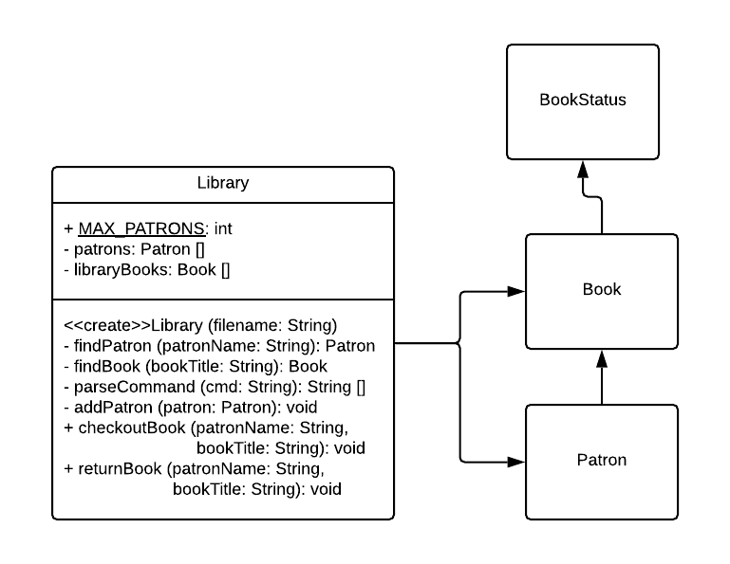
Problem Solving 1
Draw a class diagram for the Library class. Add associations to each of the classes you have already created diagrams for. Include a picture of the completed UML to the left.
Associations for the classes will be lines between the classes that know about each other.
If the knowledge is one-directional, add an arrow pointing from the knowing class to the other.

Slide 6
Problem Solving 2
public class Patron {
// Data structure to hold books
public void addBook (Book book) {
}
}
For this iteration of the assignment, patrons can check out up to 3 books. What data structure will you use to store the patrons books? Add a variable of that type to the code on the left.
Write the code to add a new book to the patrons selection of checked out books.
If the patron already has 3 books checked out, throw an IllegalArgumentException.

Slide 7
Problem Solving 2
public class Patron {
// Data structure to hold books
private Book[] books;
private int bookCount;
public void addBook (Book book) {
if (bookCount == books.length) {
throw new IllegalArgumentException
("Already have max books checked out");
}
for (int i = 0; i < books.length; i++) {
if (books[i] == null) {
books[i] = book;
bookCount++;
return;
}
}
}
}
For this iteration of the assignment, patrons can check out up to 3 books. What data structure will you use to store the patrons books? Add a variable of that type to the code on the left.
Write the code to add a new book to the patrons selection of checked out books.
If the patron already has 3 books checked out, throw an IllegalArgumentException.

Slide 8
Problem Solving 3
public class Library {
private Book[] libraryBooks;
public Book findBook (String bookTitle) {
// Add code here
}
}
In order to check out a book from the library, you first must be able to find an available book. Write a method that finds an available copy of a specified book.
If the expected book is unavailable return null.

Slide 9
Problem Solving 3
public class Library {
private Book[] libraryBooks;
public Book findBook (String bookTitle) {
for (Book book: shelves) {
if (book.getTitle ().equals (bookTitle) &&
book.getStatus () == BookStatus.AVAILABLE) {
return book;
}
}
}
}
In order to check out a book from the library, you first must be able to find an available book. Write a method that finds an available copy of a specified book.
If the expected book is unavailable return null.

Slide 10
Problem Solving 4
No Code!!
Checkout Steps:
Users of the book management system will be able to checkout a book by specifying the book's title and a patron's name. Given the class declaration snippet below, list the steps necessary to successfully checkout a book.
Do not write code
public class Library {
private Book[] libraryBooks;
private Patron[] patrons;
public void checkoutBook (String patronName,
String BookTitle){
// List steps for this method
}
}

Slide 11
Problem Solving 4
No Code!!
Checkout Steps:
Find the patron in the libraries list of patrons
If patron is not in the list of patrons, add them
Find the book in the libraries list of books
If the book isn't part of the library, throw an exception
Verify the patron doesn't already have the book checked out
Throw and exception if the book is already checked out by the patron
Add the book to the patrons list of checked out books (which marks the book as checked out)
Users of the book management system will be able to checkout a book by specifying the book's title and a patron's name. Given the class declaration snippet below, list the steps necessary to successfully checkout a book.
Do not write code
public class Library {
private Book[] libraryBooks;
private Patron[] patrons;
public void checkoutBook (String patronName,
String BookTitle){
// List steps for this method
}
}

